Slide 1




PACIFIC BRANDS
OUTERWEAR & SPORTS
NEWMARKET DISTRIBUTION CENTRE
Instructions and General Information
for
Emergency and Fire Evacuations
Issue 6: 1 September 2006
Approved by: Chief Warden
PACIFIC BRANDS
EMERGENCY AND FIRE
EVACUATION GUIDE

Slide 2

GENERAL INFORMATION
The Emergency & Fire Evacuation presentation is designed to assist all staff in dealing with an emergency situation.
When following these guidelines, the first priority is the safety of staff, contractors and visitors. Only if safe to do so, should you attempt to protect records, property and other assets.
ALL STAFF AND CONTRACTORS WORKING ON THE SITE ARE TO MAKE THEMSELVES AWARE OF THE LOCATION OF:
Fire Equipment - Extinguishers, Hoses, Manual Call points
Building Exits
Alert Tone Assembly Points
Evacuation Assembly Areas

Slide 3
TYPES OF EMERGENCIES
A full or partial evacuation of buildings may be
necessary as a result of any of the following:
Fire and Smoke
Bomb Threat
Toxic Emission
Hazardous Substance Incident
Building Invasion
Armed Intrusion
Explosion
Structural Fault
Medical Emergency
Natural Disaster
Civil Disorder
Act of Terrorism

Slide 4
FIRE PREVENTION
Working areas, stairways, walkways fire equipment and safety exits MUST be kept CLEAR of obstructions at ALL times.
All fire equipment and exits are line marked to identify those areas that must be kept clear at all times.
Report any matter, that you consider a potential hazard to your Manager, Supervisor, WHS representative or Area Warden.

Slide 5
In the event of uncovering an
Emergency Situation, the following procedures should be followed:

Slide 6
Rescue/move persons from immediate danger to safety if safe to do so.
Alert persons in the vicinity of the emergency.
Notify reception on the emergency dedicated extension 6970.
Specify – Your Name, Location and type of Emergency.
Do not contact the Emergency Services – (the receptionist will contact the Chief Warden and contact the Emergency Services).
If unanswered / after hours notify the Emergency Services direct on 000.
In the case of fire, and only if competent to do so, attempt to extinguish.

Slide 7
If at risk, evacuate the area to the desiginated. Evacuation Assembly Area.
Should an emergency occur at meal break or at the end of shift, do not leave the site.
Promptly answer your name at roll call and await further instructions from the Area Warden.
Remain quiet during roll call so the Roll Caller is able to perform their job.
If you have assembled outside your normal work area please identify yourself to the Area Warden so that you can be accounted for on the relevant roll call listing.
Remain in the designated Evacuation Assembly Area until the all clear is given.

Slide 8

Do not under any circumstances, re-enter the building or leave the site until the
“ALL CLEAR” has been given.

Slide 9
EMERGENCY WARNING SYSTEMS
  Emergency warnings, during normal office hours (7am to 5pm), will sound via the emergency alarm or via the PA system.
  After normal office hours (after 5pm), or when the PA system is inoperative, emergency warnings will be given by walkie talkie or voice.
  Alternatively, should the installed alarm system detect fire or smoke the alarms will sound automatically.

Slide 10
EMERGENCY ALARM TONES AND ACTIONS
ALERT TONE Beep - Beep - Beep
  Shut down machinery and MMHE.
  Assemble in the Alert Tone Assembly Point together with other personnel in the work area you are located in at the time.
  If you are outside your normal work area advise the Area Warden of your presence.
  Quietly await Roll Call and promptly answer your name when called.
  Identify your closest, safe exit.
  Await further instructions from the Area Warden, or
  the sounding of the Evacuation Alarm.

Slide 11
EMERGENCY ALARM TONES AND ACTIONS
EVACUATION TONE Whoop - Whoop - Whoop
  Proceed without delay via the nearest safe exit to the
  Evacuation Assembly Area.
  If a Roll Call is required at Evacuation Assembly Point, remain quiet and promptly answer your name when called.
  Remain in the designated Evacuation Assembly Area
  until the emergency is over.
  Await further instructions from the Chief Warden or your
  designated Area Warden.
Do not under any circumstances, re-enter the building or
leave the site until the “All Clear” has been given.

Slide 12
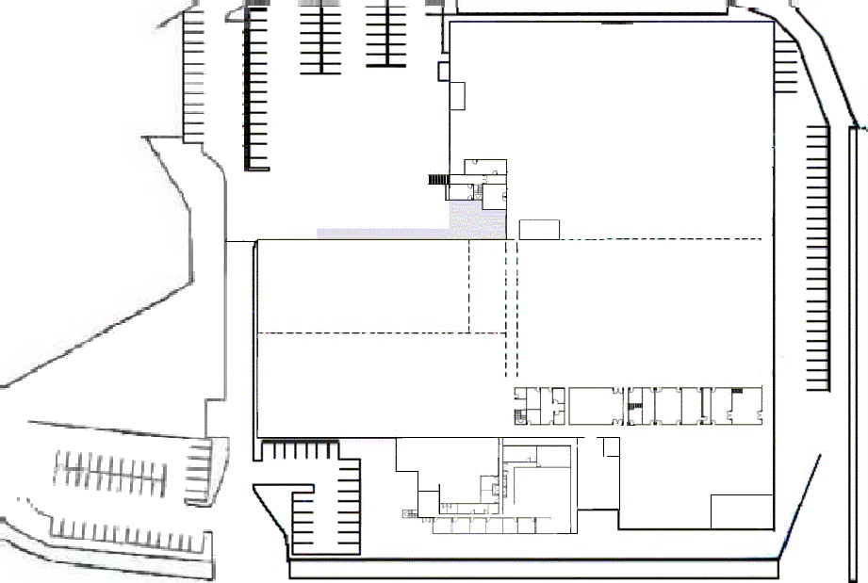



ALERT TONE ASSEMBLY POINTS
1 Bulk Warehouse
Receiving ramp
2 Active Warehouse
No parking area near staff entrance sign
3 Rework
Canteen
4 Administration & Sales
Sales office
5 Factory Outlet Shop
Near shop exit
AFTER 2.30PM
1 Bulk & Active Warehouse
Receiving ramp
6 All occupants front half of building
Reception
LOWER LEVEL EMERGENCY MAP
EVACUATION ASSEMBLY AREA BACK
2
2
GATE 2
GAS BOTTLES
1
1
GATE 1
Fire Hydrants
Fire Hose
5
Fire
M.C.P.’s
5
T
u
n
n
e
l
3
EVACUATION ASSEMBLY AREA FRONT
4
3
4
Extinguishers
Exits
Booster
6
6
First Aid Kits
RECEPTION
Fire Panel
Mina Parade

Slide 13




UPPER LEVEL
EXIT
ALERT TONE ASSEMBLY POINTS
REFER TO LOWER MAP FOR LOCATION
2 Active Warehouse Mezzanine
Downstairs with other active warehouse staff at
No parking area near staff entrance sign.
4 Upper Front Offices and Sales
Downstairs Sales Office
AFTER 2:30PM
1 Active Warehouse Mezzanine
Downstairs receiving ramp
6 Upper Front Offices and Sales
Downstairs reception.
EXIT
EXIT
EXIT
EXIT
Fire Hydrants
Fire Hose
M.C.P.’s
EXIT
EXIT
EXIT
Extinguishers
EXIT
Mains Power Supply Room
Exits
EXIT
EXIT
EXIT
First Aid Kits
EXIT
EXIT
EXIT
Mina Parade

Slide 14
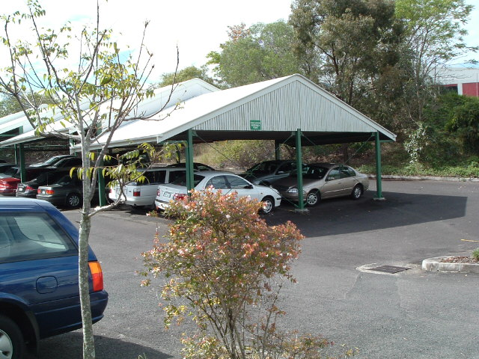
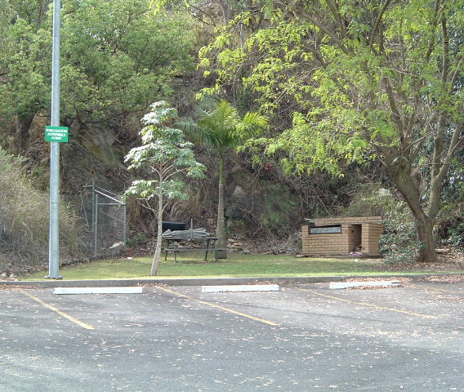

Slide 15
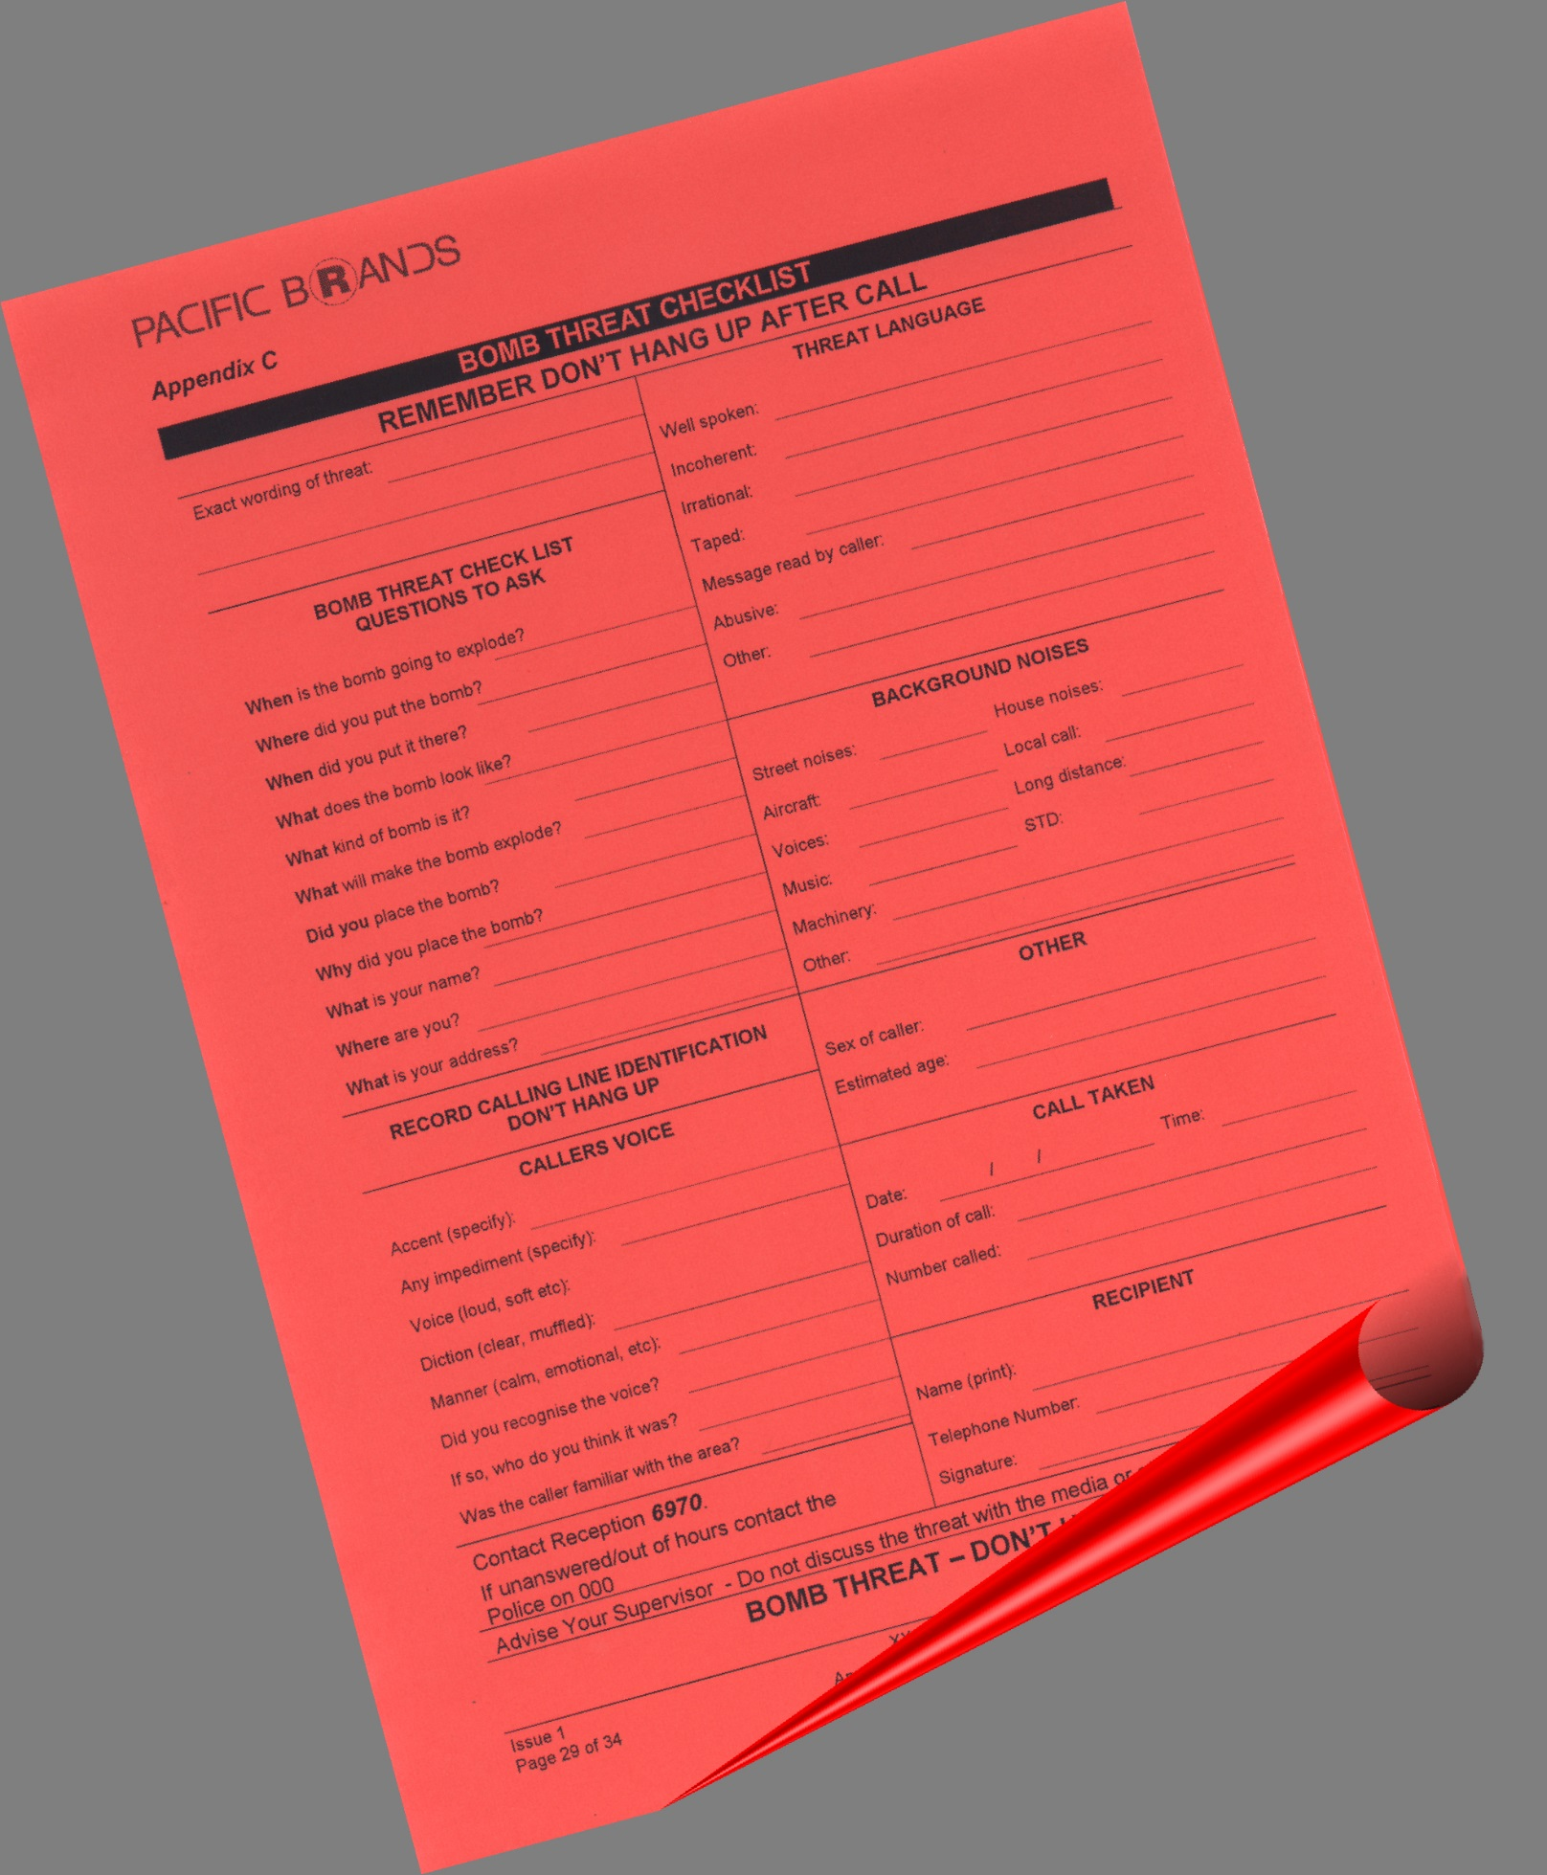
All Pacific Brands staff
with telephones should
have at hand,
near to their telephone,
a copy of the
Bomb Threat Checklist.

Slide 16


BOMB THREAT
  The course of action for a threat made by phone is:
  DO NOT INTERRUPT - DO NOT HANG UP
Try to remain calm.
Let caller finish message.
If asked for a response, keep your answer to one or two words.
Record information on bomb threat checklist or nearest paper.
Try to attract the attention of person/s near you to notify reception of threat.
WHEN THE CALLER HANGS UP, DO NOT REPLACE THE RECEIVER, THE CALL MAY BE TRACEABLE EVEN THOUGH THE CALLER HAS HUNG UP.
Report threat on another telephone to reception on emergency extension 6970 and to Area Warden or Manager.
Do not discuss details of the threat with the media or any other person unauthorised to receive such details.

Slide 17
ARMED INTRUSION / BUILDING INVASION
DON'T TURN A ROBBERY INTO A MURDER.
NO AMOUNT OF MONEY, EQUIPMENT OR INFORMATION IS WORTH A LIFE.
IMMEDIATE ACTION IF CONFRONTED
Try to remain calm or appear to be calm.
Do not make any sudden movement or take any action to excite intruder.
Be courteous, converse with and answer questions asked by the intruder.
Obey all instructions given by the intruder/s, hand over valuables, cash, products etc on request.
Take a mental note of characteristics such as:
Gender / Age / Height / Build / Weight / Colour of hair & eyes / Complexion
Speech / Scars or other markings / Dress / Unusual Mannerisms
Items touched by the intruder / Vehicles used
When an intruder departs DO NOT GIVE CHASE.
Report details to the Chief/Area Warden or Senior Manager.
DO NOT discuss your version of events with others.
Complete an Armed Intrusion Checklist and be prepared to talk to the police.

Slide 18
IN AN EMERGENCY SITUATION OVERALL DIRECTION OF ALL STAFF, CONTRACTORS AND VISTORS ON SITE IS UNDER THE CONTROL OF THE
EMERGENCY CONTROL ORGANISATION
THEIR DIRECTIONS MUST BE OBEYED BY ALL!

Slide 21

Any questions …
please see your Area Warden

